Slide 1
Thesis Discussion
24 July

Slide 2
Topics Overview
Data modelling
Security
CTI Sharing
Related Projects
Data spaces
Privacy Enhancing Technologies (PETs)

Slide 3
Data Modelling
Open Information Systems by Christophe Debruyne
Semantic Web
RDF
Ontology
[-] Protege
[-] Close-World vs Open-World Assumption
[-] RDF SHACL

Slide 4
Security
Siem System
Managed Security Service
Cyber Threat Intelligence
Data Sources
Situational Awareness
Crusoe Paper
The Pyramid of Pain

Slide 5
CTI Sharing
Formats
IODEF
STIX
MISP Core Format
MISP Taxonomies (Vocabularies)
MISP Galaxies
MISP
STIX
EE-ISAC
OSINT
Shodan
Sharing is Caring Paper

Slide 6
CTI Sharing (Cont.)
Sharing Barriers:
Legal and Regulatory (Liability / NDA)
Interoperability (Various Formats)
Cost/Benefit
Market Factors (Weaknesses, Free-riding)
Trust in Peers and Adversarial Usage
Confidentiality
Sharing Standards and Their Fields
VERIS
IODEF
STIX (-> Ontology)
OpenIOC
IDEA
MISP’s Internal Format
Technical Challenges
Architectures and Trust Management (TAXII, MiRTrust, Blockchain)
Expression and Languages (natural lang. Reports, TTPs, APT, STIX + OWL)
Data Sources (directed, OSINT, Honeypots, logfiles, TISP, Correlation)
Data Quality (Duplicates, quality indexes, reputation, AI generated fake CTI)
Actionability and Consumption (Cost/Benefit, Operationalizing, Attack modelling, vague CTI, Playbooks, SOAR)
Confidentiality Analysis
Disclosure Risks
Confidentiality Model
LINDDUN
Fisk
Linkability and Identifiability
Non-repudiation
Detectability
Disclosure of Information
Content Unawareness
Policy/Consent Noncompliance
PET
K-anonymity
L-diversity
Data Masking
Secure Computation
Identity (Reputation, Incentive, Anonymization)
Requirements
Identity
Bidirectionality
Collaboration
Actionability
Safety
Proposed Architecture

Slide 7
Related Projects
SAPPAN-Project
D4.1 (MISP vs STIX)
D5.7
Phoenix
D4.2
D2.3

Slide 8
Data Spaces
Dataspace concept
Data Sovereignty
FAIR principles for data management
IDSA
How sovereignty is achieved? Usage Policy, Connector, Data apps
Reference Architecture
IDS Test Bed
GAIA-X
FIWARE

Slide 9
Privacy Enhancing Technologies
Differential Privacy
Federated Learning
Secure Aggregation
SMPC
Anonymization
Homomorphic Encryption

Slide 10
Plan
Requirement Analysis
Data Modelling
Risk Analysis (Confidentiality/Privacy Analysis)
Data Sanitization
Implementing the Dataspace

Slide 11
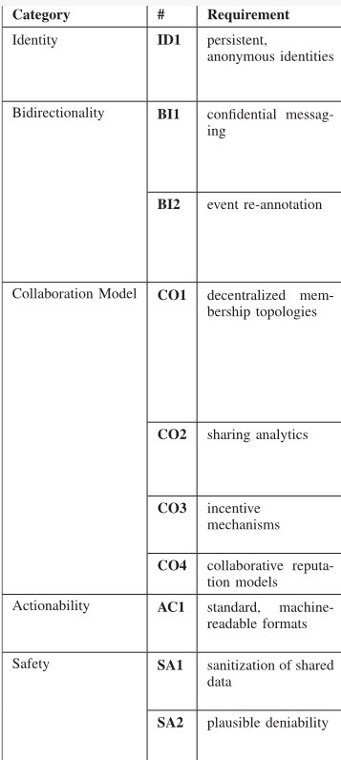
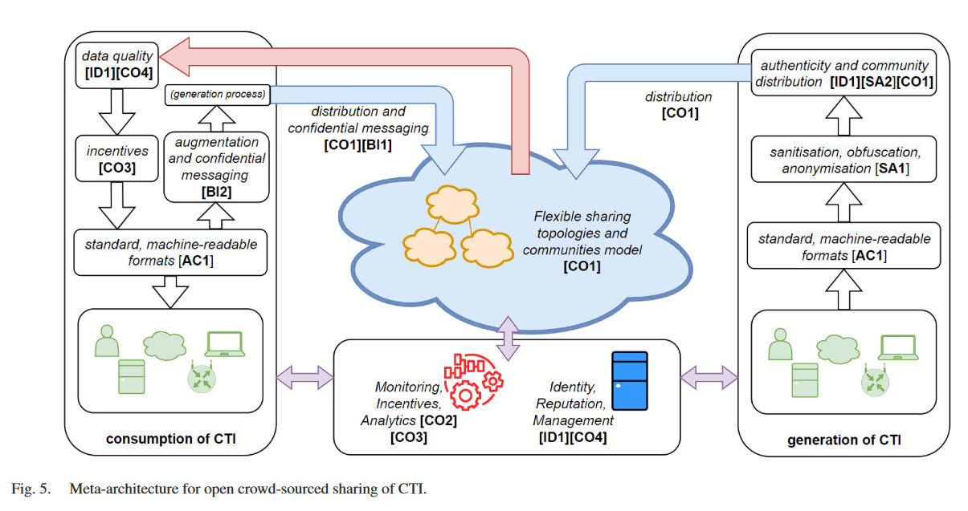

















Sharing is caring
Notes:
Green: Easy in Dataspaces
Yellow: Different but manageable
Orange: Needs to be defined
Blue: Not sure if necessary

Slide 12
IDSA
Resources
IDSA RAM
How to build
Protocol
Implementing IDS
Testbed: Connector + Daps
IDSA app store is down
Sovity
Dataspace Protocol -> Specifications
Data Catalog: DCAT Catalogs
Usage Control: ODRL Policies
Business Part
Web3

Slide 13
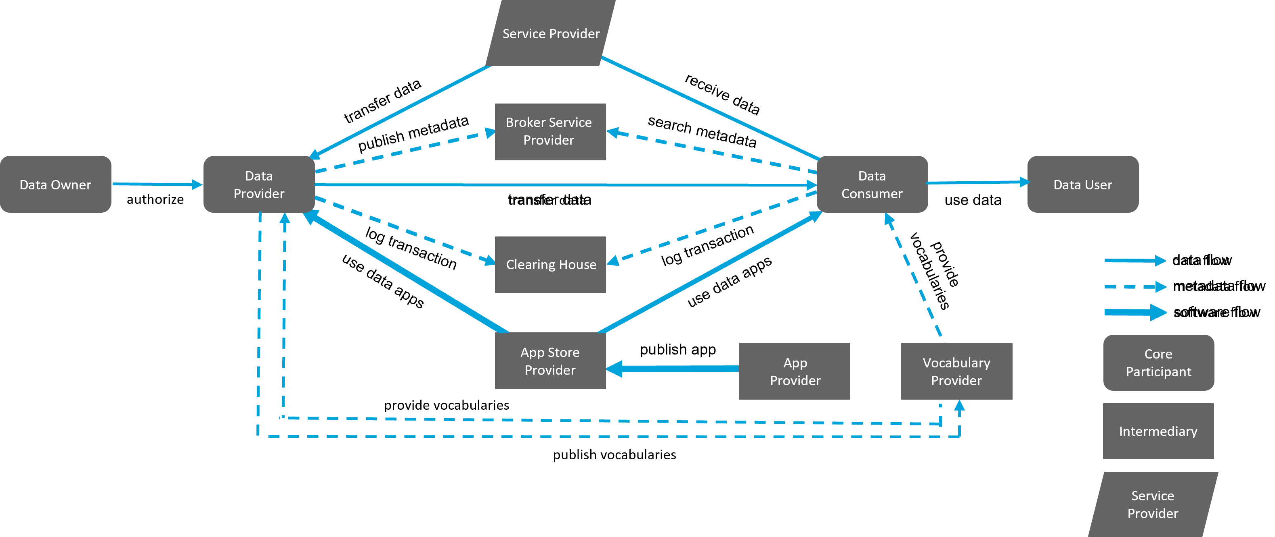
IDS Roles

Slide 14
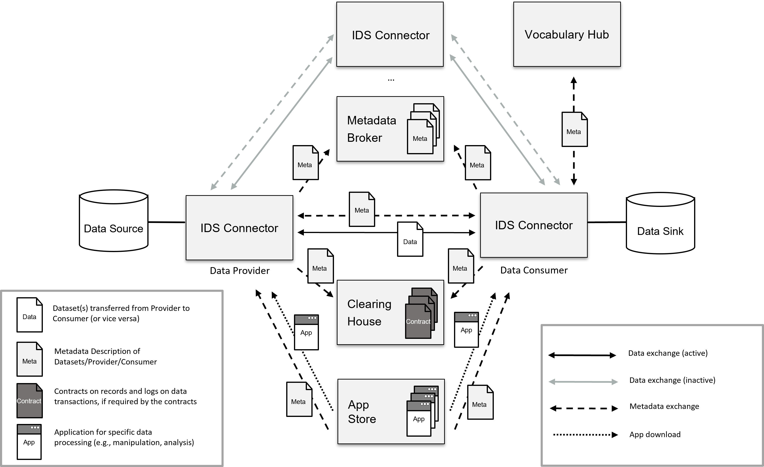
IDS Components

Slide 15
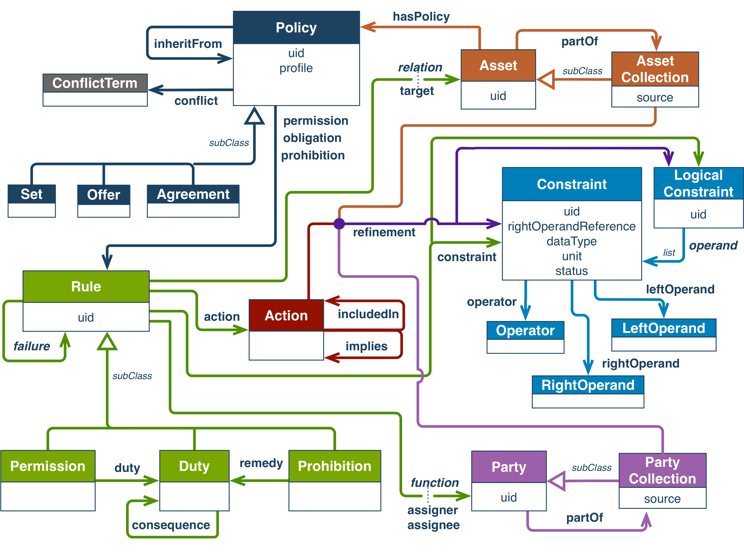
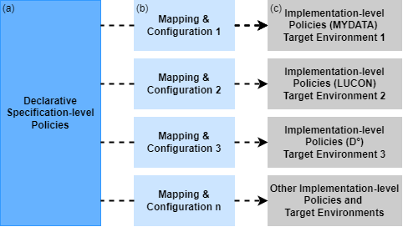
IDS Usage Control
ODRL policies are a formal way to declaratively express Usage Control policies at a specification level
technical measures involve a variety of additional information sources (PIPs) and tight integration with the host environment (PEPs)
“These Policy Classes can be instantiated and combined to form an identified IDS Usage Control Policy. For example, a Data Provider can specify a policy as follows: a Data Consumer shall use my data not later than the end of December 2024 and only when the location is Germany. Also, the data usage information shall be logged, and all the copies of the data shall be deleted not later than a delay period of one month”

Slide 16
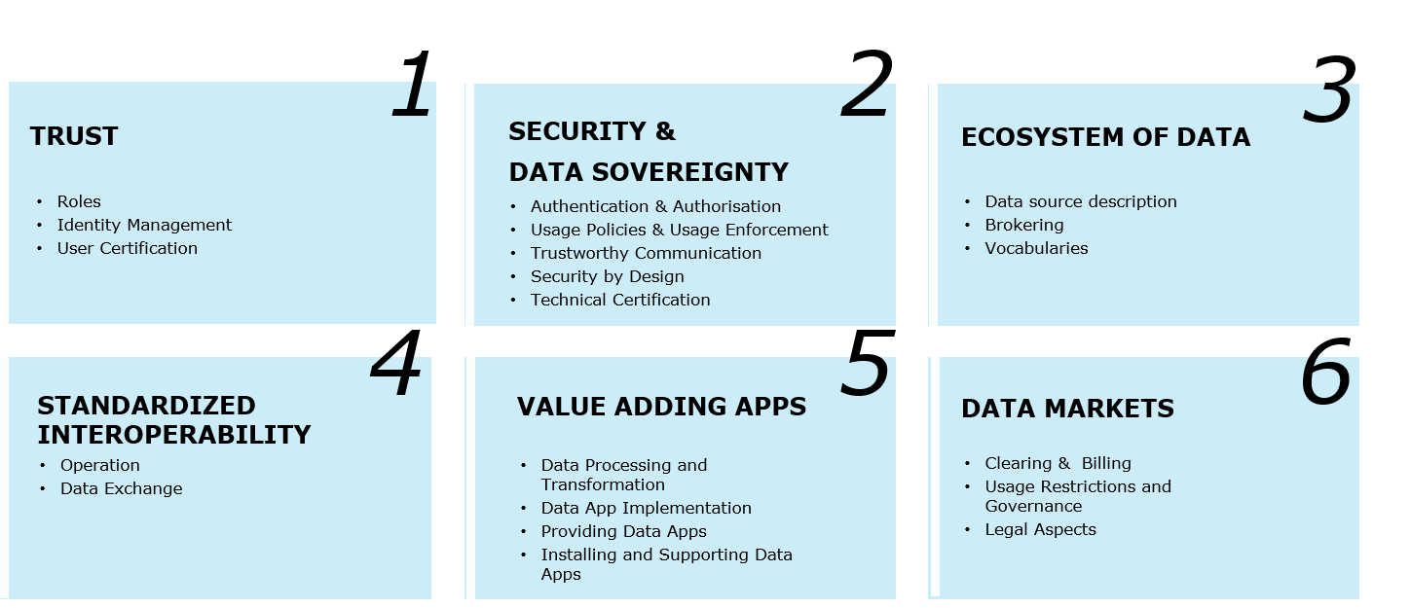



Functional Requirements

Slide 17
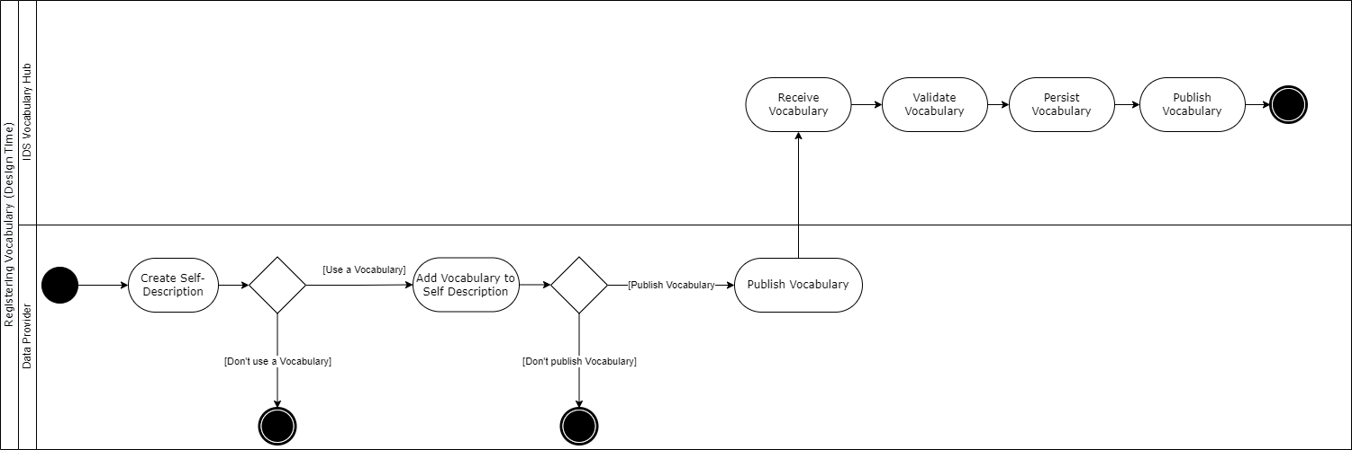
Register Vocabulary

Slide 18
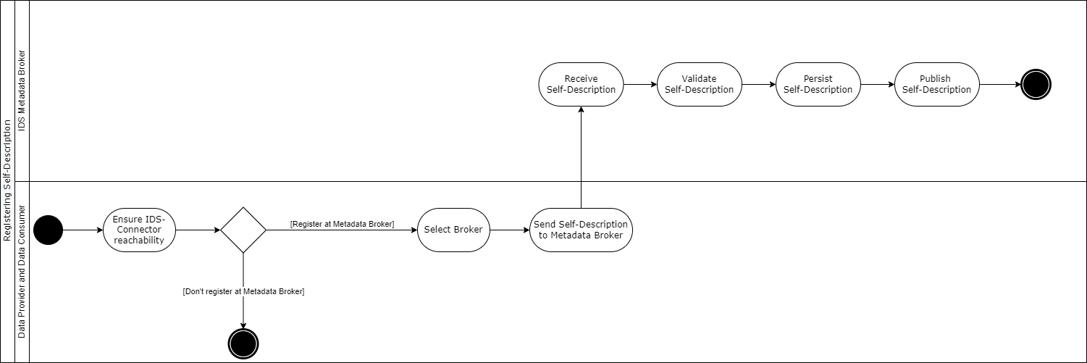
Register Self-Descriptions

Slide 19
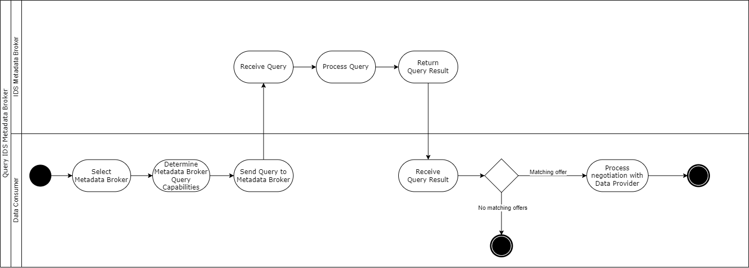
Query IDS Metadata Broker

Slide 20
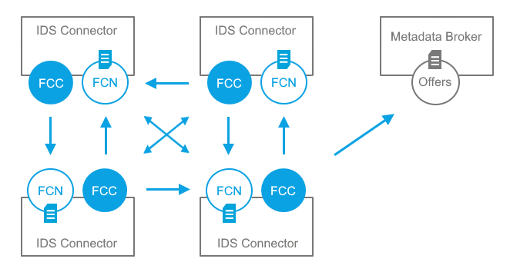
Federated Catalogue

Slide 21
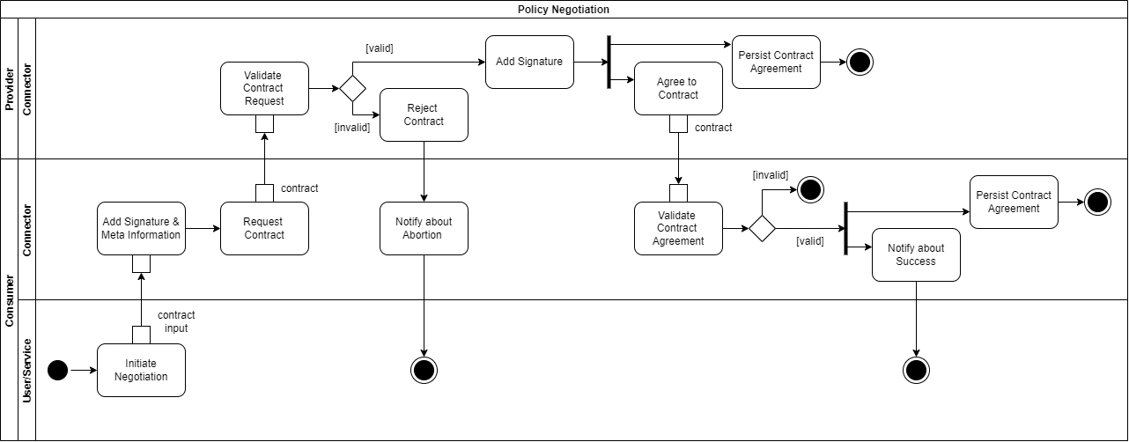
Contract Negotiation

Slide 22
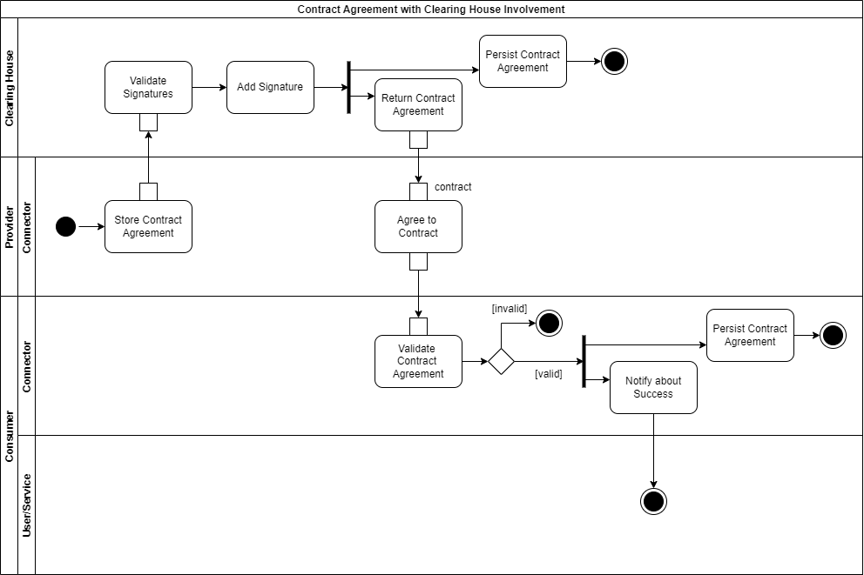
Clearing House

Slide 23
TODO
Use Case
Phoenix
CyberSEAS
Keywords: IEC62443,IEC62351,GDPR,ENISA,NIS,NIS2
Requirements
Create a list
Dataspace features
MYDATA https://developer.mydata-control.de
Position paper usage control https://internationaldataspaces.org/wp-content/uploads/IDSA-Position-Paper-Usage-Control-in-IDS.pdf

Slide 24
Question
Typical CTI Sharing Actors in Energy Sector
Common CTI Sharing Actors
Private Companies
Private Critical Infrastructures
Government
IT Security Firms
Security Researchers
IT Vendors
Notes:
granularity of actors: Ssometimes you can mention different parts of the government for example. It depends on the use case description.

Slide 26
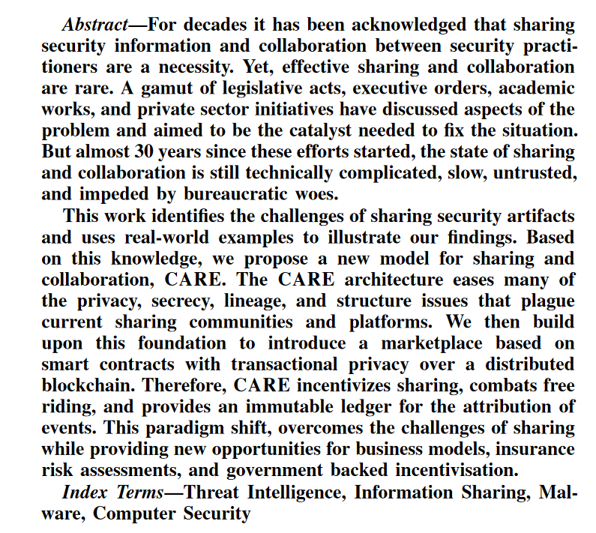
Notes
Sharing is Caring: Collaborative Analysis and Real-time Enquiry for Security Analytics
2018 IEEE International Conference on Internet of Things (iThings) and IEEE Green Computing and Communications (GreenCom) and IEEE Cyber, Physical and Social Computing (CPSCom) and IEEE Smart Data (SmartData)
Sharing is Caring again :D

Slide 27
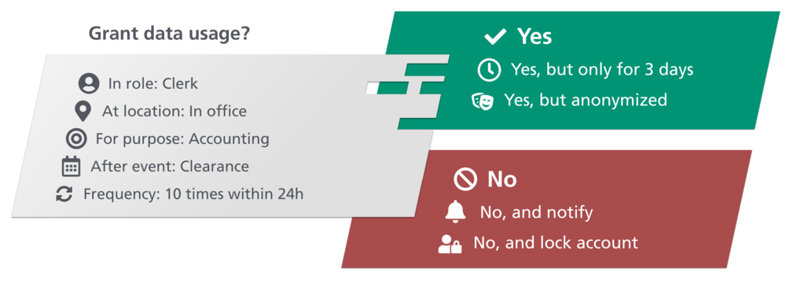
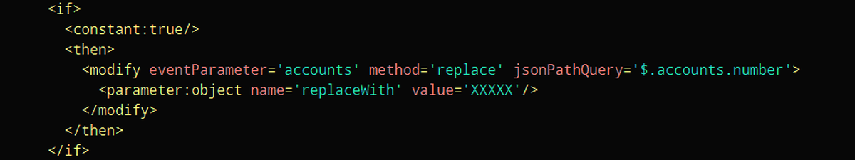
MY DATA Control Technologies
Policy Enforcement
Event Monitoring, Filtering and Masking
Execution of Actions
Connecting to External Information Sources

Slide 28
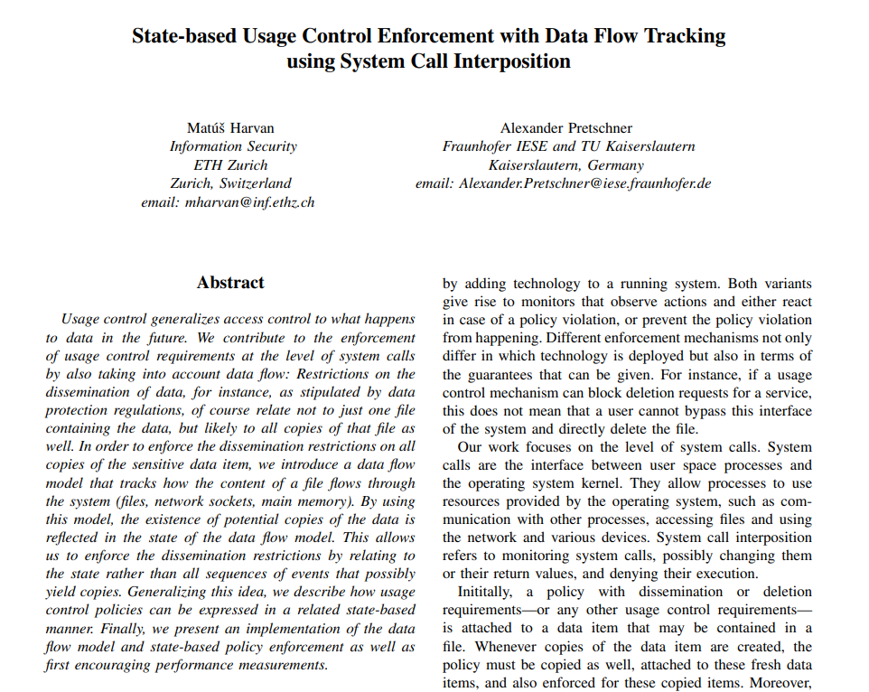
Usage control enforcement
Other approaches
Common practice?

Slide 29
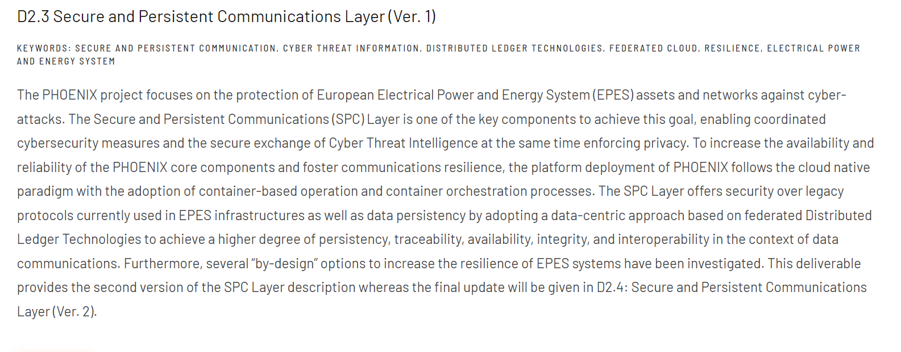
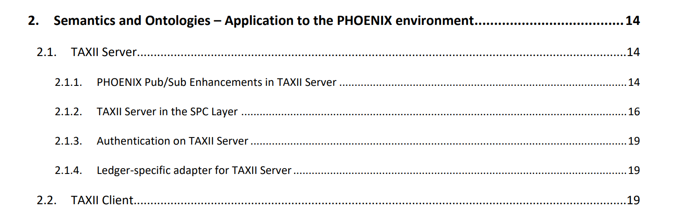
Phoenix
Protecting European Power Systems
Deliverables

Slide 30
Sappan
standard for an interoperable and machine-readable description of playbooks, making use of semantic technologies

Slide 31
Misp

Slide 32
Misp Features
Efficient IOC Database
Automatic Correlation
Flexible Data Model using objects
Built-in Sharing Functionality
+ Kafka
Intuitive User Interface (+event graph)
Storing data in a structured format
Import/Export to various formats and tools
Free text import
Collaborative UI
Expandable taxonomies and galaxies
Sighting

Slide 33
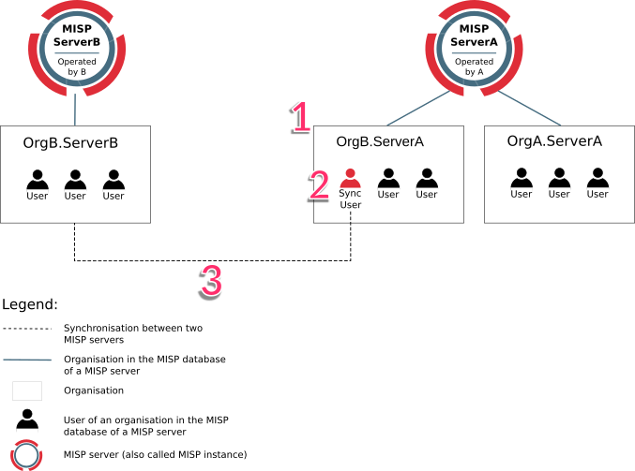
Misp Sharing
Synchronization
Pull vs Push
Misp Sharing Levels:
Your organization only
This community only
Connected communities
All communities
Sharing Models
Source and Subscriber
Hub and Spoke
Peer to Peer
Hybrid

Slide 34
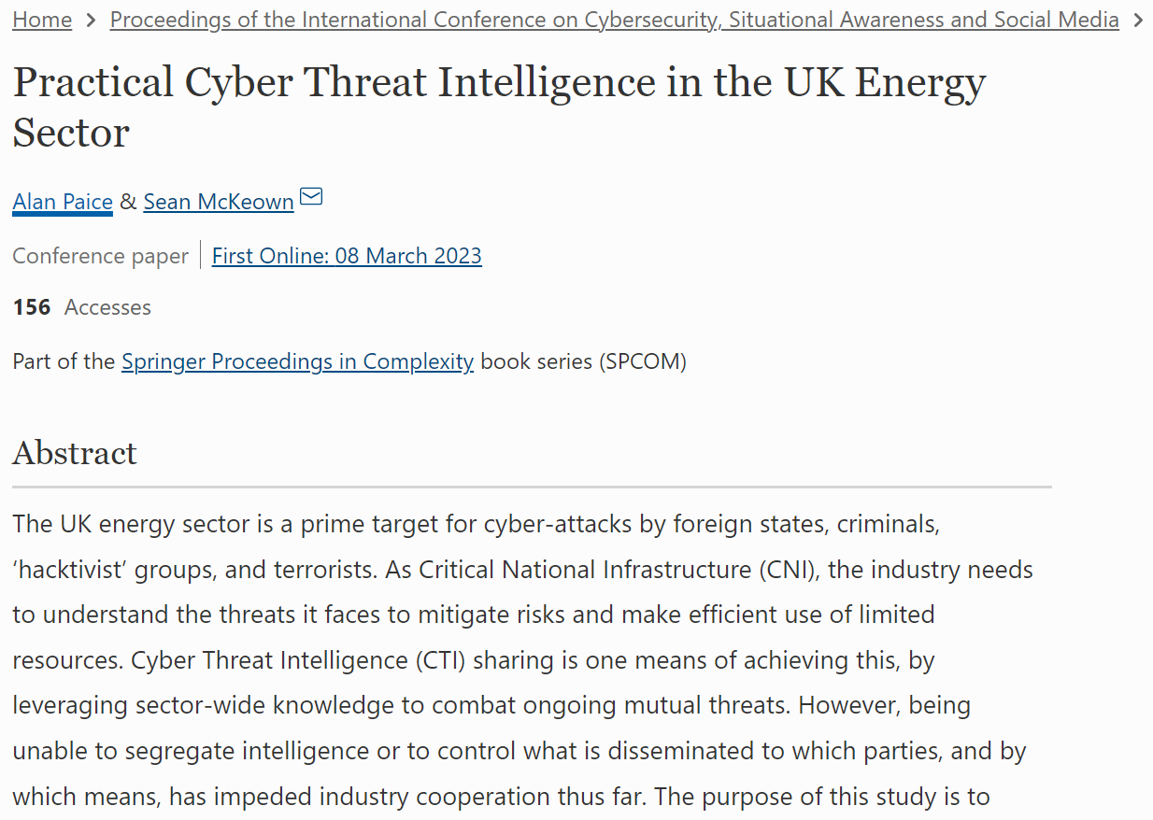
Misp usage in energy sector

Slide 35
Requirements

Slide 36
CTI Information Sharing Barriers
Operational Barriers – Lack of trust between participants – Unavailability of knowledgeable, experienced employees
Technical Barriers – Lack of common standards – Large variety of Taxonomies and used protocols – Additional technical resources required
Financial Barriers – Additional costs for infrastructure, data feeds and human resources. – No direct return of investment
Legal/Policy issues – Lack of General Security agreement – Information sharing depends highly on local / legal requirements.

Slide 37
Barriers in open CTI Sharing
Barriers
Legal and Regulatory (Liability / NDA)
Interoperability (Various Formats)
Cost/Benefit
Market Factors (Weaknesses, Free-riding)
Trust in Peers and Adversarial Usage
Confidentiality
Technical Challenges
Architectures and Trust Management (TAXII, MiRTrust, Blockchain)
Expression and Languages (natural lang. Reports, TTPs, APT, STIX + OWL)
Data Sources (directed, OSINT, Honeypots, logfiles, TISP, Correlation)
Data Quality (Duplicates, quality indexes, reputation, AI generated fake CTI)
Actionability and Consumption (Cost/Benefit, Operationalizing, Attack modelling, vague CTI, Playbooks, SOAR)

Slide 38













Requirements
Evaluate feed quality before contract
Data sample, Evaluation by third party
Feedback
Reviews, Sighting of indicators
Digital Trust Infrastructure: Does this feed belong to this actor? Is this actor adversary?
(Without regular face to face meetings)
+ Data spaces (DAPS)
Clearly defined contract (Usage policies): How much data for how much money?
+ Automatic usage restriction enforcement (MYDATA)
+ Usage tracing (Data Provenance)
Data providers should be able to verify whether their data is safe to share
trusted automatic sanitizer
Standard formats
Realtime: Low generation to consumption time
Security and Data integrity
Ease of use (Good UI)

Slide 39
Evaluation
Implementation of Proof-of-concept
Check if usage policies are enforced
Measure performance overhead
Check sanitization accuracy

Slide 40
TODO
Conceptual Approach
Define conceptual MISP: GMISP
Describe how DS could be integrated with GMISP
Sovereign MISP
Look at MISP data level
Evaluation Metrics
Check other DS applications for evaluation!

Slide 41
Next Meeting
05.10.2023

Slide 42
Thesis Logical Sequence
Goal: CTI Sharing, why it’s needed
+ Scenario
Barriers: Why it’s not industry standard, Real-world scenarios.
Requirements: What functionalities should a solution have.
Conceptual approach: How a DS based solution can fulfill the req.
Evaluation
Discussion
Case-study: Review current DS implementations
Result analysis
Conclusion
Future work

Slide 43
Conceptual Approach
Identity Management
Automatic Sanitization
Usage policy enforcement
Feedback (reannotation, sighting, rating)
TBD (Broker?)
Reputation Management
TBD (Broker?)
Cataloguing
Cloud vs On-prem

Slide 44
Identity Provider
DAPS
Certificate Authority
IDS Connector
App
Sanitizer
Core
MYDATA

Slide 45
Evaluation
Type of evaluation
Performance metrics: measure some metrics that indicate performance
Testing and validation: Run scenarios, check requirements
Ease of use: Setting up difficulty (bootstrapping overhead), MISP UI, Policy control UI, known metrics
Security assessment: pentest, risk analysis.
Measure access control, encryption, logging
Compare identification mngm.
Compliance with regulations (e.g. GDPR)
Theoretical frameworks
Privacy: Linddun
Threat modelling: STRIDE
Data integrity: corruption, checksum, backup and versioning
Comparative Analysis: (e.g. with MISP)
Pros and Cons
Evaluate sanitization quality
List of sample feeds, manual labelling of sensitive data, % of removed
Evaluate usage policy
Measure performance of some features of usage policy enforcement (e.g. Time, accuracy, usability)
Time and difficulty of removing leaked information
Scalability and Resource Usage: CPU, memory, network and storage
Bootstrapping overhead: How many systems to configure, estimated man-week needed

Slide 46
Plan and Methodology
Literature Review: Cybersecurity, Data Governance, Data Sharing, Dataspaces.
Find related studies, frameworks, and methodologies
(Cancel) CTI Formats and Sources Analysis
(Cancel) Confidentiality/Threat/Risk Analysis (?)
Requirement Elicitation
(Cancel) Data Collection: Sample CTI for evaluation
Implementation of the Architecture
Evaluation

Slide 47
Scenario
Sharing Models: P2P, Hub-Spoke, Hybrid
We need at least one Scenario
Sharing between SOC levels in MISP
Report to CERT
Structure/Standard
Collaborative
Better Collaboration / Automatic
Situational Awareness
Evaluation:
What could be shared
How much more data could be shared

Slide 48
Next Meeting
13 October

Slide 49

Book

Slide 50
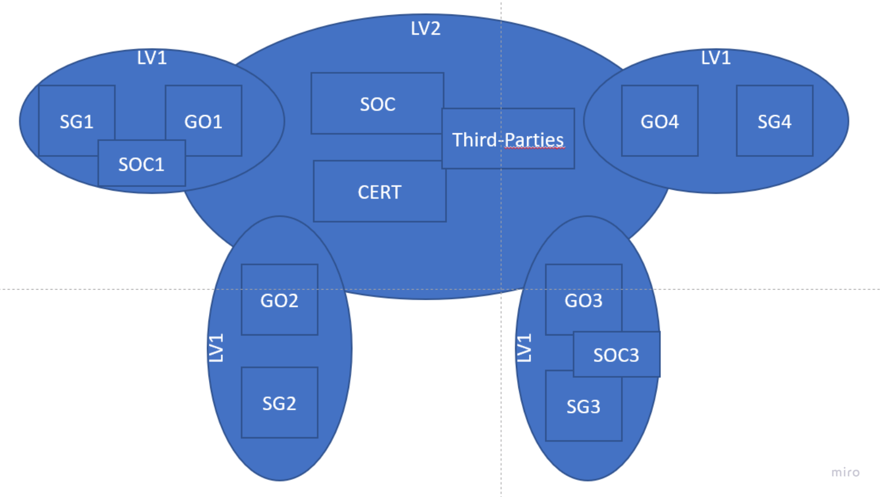
Scenario – Part 2
Security Improvement for Utility Providers: Utility providers are looking to enhance their security measures due to being potential targets of Advanced Persistent Threats (APTs) and targeted attacks. (CNI)
Need for Customized CTI Sharing: General-purpose CTI providers and Open-Source Intelligence (OSINT) are not sufficient for their needs. They seek a platform that allows for tailored CTI sharing.
Existing SOC and CTI Program: These providers already have Security Operations Center (SOC) teams and CTI programs in place, indicating a degree of security infrastructure.
Non-Repudiation: Data owners intend to establish non-repudiation mechanisms, which can be crucial in holding responsible parties accountable in case of policy violations or data breaches.
Confidentiality and Access Control: Utility providers want to control access to data by configuring which participants can access specific types of data based on its confidentiality level. They aim to restrict data usage to SOC or similar security departments, excluding marketing and development departments.
Paying for Non-Sharing Participants: Some participants may be unwilling to share CTI but are still required to contribute financially.
Public-Private Sharing: Occasionally, national Computer Emergency Response Teams (CERTs) request security reports from all participants. These participants trust the CERT and are willing to share information. (+Regulations).
Certified Systems Requirement: CTI should only reach systems that meet specific security standards to prevent data breaches.
Ease of Onboarding: The platform should allow new utility providers to join easily, as and when they see it as a valuable resource.
Avoiding Proprietary Management: Utility providers want to avoid vendor lock-in and trust issues by not using a proprietary third party to manage their data.
Data Sovereignty: Participants are concerned about data sovereignty, indicating a desire to have control over their data.
Notes:
Several utility providers want to improve their security postures.
They are potential target of APTs and targeted attacks.
OSINT and general-purpose CTI providers are not enough.
They already have SOC teams and CTI program in-place.
They want to have platform for sharing CTI.
In the event of policy violations or a data breach, the data owner intends to hold the responsible party liable: non-repudiation is needed
They compete in the same market, so they do not want to disclose their competitive advantage. They want to be able to configure which type of data (confidentiality level) can be read by which participants. Also, they want this data to be used only by the SOC or similar department and not marketing and development departments.
They want Some participants are not willing to share, but they must pay.
Occasionally, there is request from national CERT for a security report from all participants. The participants trust the CERT and are willing to share all the information.
The CTI should only reach certified systems that has a level of security standards to prevent breach.
The platform should allow new participants to join easily, as new utility providers find this platform useful at any time.
A proprietary third party managing all the data can’t be used. To avoid vendor lock-in and trust issues.
The participants want to have data sovereignty over their data.

Slide 51
Background -- Threat Environment
Threat and its taxonomies
Accidental / Intentional
Active / Passive
STRIDE
threat + vulnerability -> Risk
CTI helps Risk management and vice versa
Vulnerability: Human/Configuration/Software Bugs
Threat Actors:
APTs / State-Sponsored / Criminals / Hacktivists / Insider / ...
Characteristics: Intent / Access / Resource / Skill / ...
TTP:
Mitre and ATT&CK: Reconnaissance, Resource Development, ...
CAPEC / CWE
Kill Chain
Threat Landscape (changes!) / Victimology
Attack Vectors (USB, Email, Web, Supply Chain, ...) / Targeted Attacks

Slide 52
Background – CTI Application
Gathering
NIST Security framework
intelligent program: metrics, maturity (producer/consumer)
Principles: CROSSCAT (Centralized, Responsive, Objective, Systematic, Sharing, Continuous Review, Accessible, Timely)
Metrics: Operational / Tactical / Strategic
Intelligence Cycle
Planning / Collection / Analysis / Production / Dissemination
Dissemination: Security Level, Timely
Trade-off: 1) Over sharing, risky, adversarial access 2) Restrictive, no benefit
Situational Awareness: Most mature: Predict future. Common pitfalls
Goal Oriented Security and Threat Modelling:
Quantitative Threat Modelling / PASTA / Attack graphs
CTI Products
Strategic: Who? Why?
Operational: How? When?
Tactical: What? How? → IOCs
Incident Preparedness and Response
Mitigation: Deter, Deny, Detect, Delay
IR Process: Detection, Analyze, Recover, Improve
STIX Objects

Slide 53
Background – CTI Sources
Free / Membership / Paid
Producers
National intelligence/Cyber agencies
Commercial Cyber security companies
Industry peers
Individual Researchers
TLP: Traffic Light Protocol
No legal basis and enforcement
Widely used in the CTI community

Slide 54
CTI Sharing Benefits
Finding Threat Actors:
Attackers keep their TTPs
They own a particular capabilities and infrastructure

Slide 55
Sample Data
Stix objects:
Intrusion-set
Threat-actor
Identity
Indicator
Malware
Tool
Attack-pattern
Report
On Stix website:
Mandiant's APT1 Report
An in-depth threat report by Mandiant
focused on a sophisticated APT simply called “APT1”.
Conducted cyber espionage campaigns sponsored by the Chinese government

Slide 56


News
Guard Project: Securing digital service chains
Repetto, Matteo. “Adaptive Monitoring, Detection, and Response for Agile Digital Service Chains.” Computers & Security 132 (September 1, 2023): 103343. https://doi.org/10.1016/j.cose.2023.103343.
Huawei PhD offer:

Slide 57
Next Meeting

Slide 58
Solution Overview – CTI Bazaar
Sovereign marketplace for CTI data -> CTI Bazaar
Not scalable
Not shared with enough people and timely
Interoperability
No standard -> Ad-hoc -> more effort
Legal and Regulatory constraints
Trust and adversary Usage
Market Factors
Public crowd-sourced Collaborative CTI (C-CTI)
Private ad-hoc C-CTI
Our solution: best from each side

Slide 59
Areas of use
Any sector with many cooperating organizations having fundamental IT components that require high cyber security levels
Critical National Infrastructures -> ISACs
Energy (Smart Power Systems) -> Our focus of experiments
Economic (Banking and Insurance)
Health (Hospitals)
Transportation (Smart Mobility)
...
Private Sector
Industry 4

Slide 60
Bazaar – Smart Grid Use Case
Situation: Community of diverse energy sector organizations.
Objective: Sharing CTI (Cyber Threat Intelligence).
Mandatory or Voluntary: Compliance with NIS2 or voluntary for security enhancement.
Participants: Security teams or managed security services.
Diversity: Different countries, regulations, languages, and cultures.
Varying Trust Levels: Participants have different levels of trust

Slide 61
Scenario 0 – Join and Explore
Organization B: Interested in Joining the Platform
Certification Process:
Committee Approval: Decision-making community members review and approve the request.
Technical Certification: Admins verify technical compatibility.
Platform Access:
Connection: B gains access to the platform.
Search Capability: Ability to search for available data assets.
Metadata Retrieval: Fetch metadata for the assets.
Member Exploration: Explore existing members and their reputation.
Notes:
Define Metadata!

Slide 62
Scenario 1 – Manual 1-1 Sharing
SOC analyst from org A (Alice) has found some info about a threat actor (TTP, Identity, Addresses) and want to share with org B (Bob)
Alice checks which format is supported by bazaar
Alice creates CTI records and its description (metadata) in one of standard formats
She could also use some standard TISP (e.g MISP) to convert it automatically
For metadata she specifies an expiry date (e.g., 30 days) and sharing range (only within EU)
Alice publishes the metadata in bazaar using its Connector
Bob searches available data in Bazaar and then after agreeing with terms and conditions can read the data but only in security certified machines

Slide 63
Scenario 2 – Community Sharing
Utility Provider: Acme
Malware Discovery: New malware in Acme's network
Information Sharing: Through Bazaar platform
Data Usage Policy:
EU Data Processing: Restricted to Bazaar Connectors within the EU (GDPR compliance).
Minimum Trust Level: Data accessible only to participants meeting a specific trust metric.
Exclusion of Competitors: Blacklisting competitors in the same market.
Notes:
Define Trust Metrics -> Data model

Slide 64
Scenario 3 – Vendor CTI
Security firm (Acme) continuously investigates the IOCs related to an APT that targets a certain supply chain and publishes these data in Bazaar in a CTI feed. All participants in this chain wants to constantly get updates from this feed by paying a monthly subscription fee to Acme.
A SOC analyst from the supply chain company (Bob) save the payment receipt in its Connector and then initiates the consumption of the Acme feed.
After each new record (e.g., IOC), Bob gets notified and feeds this IOC to the company’s IDS systems.
Notes:
SOC as a service: part of MSSP
MSSP: detects incident
Response: Playbook

Slide 65
Scenario 4 – Provenance Checking
Non-repudiation

Slide 66
Requirements
Usage Control
Based on location
Data Retention
Blacklisting
Trust level
...
Certification
Non-Repudiation
Anonymization (out of scope)
Confidentiality
TLP
Sanitization

Slide 67
Next Meeting
30 October

Slide 68
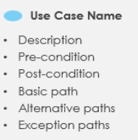
Basic Definitions
Cyber Threat Intelligence vs Information
Security analyst uses SIEM and other security information to create CTI
SIEM vs SOAR
SIEM corelates/aggregates network and access information to generate security alerts
Use case scenario: Dialogue between system and user
Actors/Success Scenario/Extensions
User Story: As a [user] I want to [functionality] so that [benefit].

Slide 69
Next Meeting
24 November

Slide 70
Proposal Talk
Time: 2023-12-06 10:30 - 11:00 (30 minutes incl. Q&A)
Student Name: Navid Rahimi Danesh Thesis type: MA Proposal Thesis title: Implementing a platform for sharing cyber threat Intelligence based on data spaces Advisors: Mehdi Akbari Gurabi, Ömer Sen Supervisors: Prof. Dr. Stefan Decker
Location: Seminar room I5 6202 Status: confirmed

Slide 71
Table of Content – Introduction and Background
Motivation
briefly about CTI sharing barriers
importance of data spaces and data sovereignty
Goal: Reach the following contributions
In the domain of Collaborative CTI:
Evaluation of Data Space Potentials and Limitations
Designing an architecture and implement proof of concept
Find and describe a convincing use case within smart grid domain
Provide guidelines and recommendation on Data space design
Background
Cyber Security
Define Smart grid
Smart grid security
CTI
Collaborative CTI
barriers
Data Sovereignty
Data space concept
Data Sovereignty and Usage Control
Notes:
motivation
Anecdote CTI sharing barriers (cite)

Slide 72
Related Work
Existing CTI Sharing Standard Platforms
MISP and STIX (TAXI)
Add data integrity guarantees to TAXII (Pahlevan et al.)
MISP applicability in UK Energy Sector (Paice et al.)
Some others (less detailed)
(done) Current Dataspace Initiatives
IDSA and Gaia-X
(done) Open-Source CTI Sharing
Applications of data space
TIKD: A Trusted Integrated Knowledge Dataspace For Sensitive Healthcare Data Sharing
Hasnain et al. 2014 – Linked Biomedical Dataspace

Slide 73
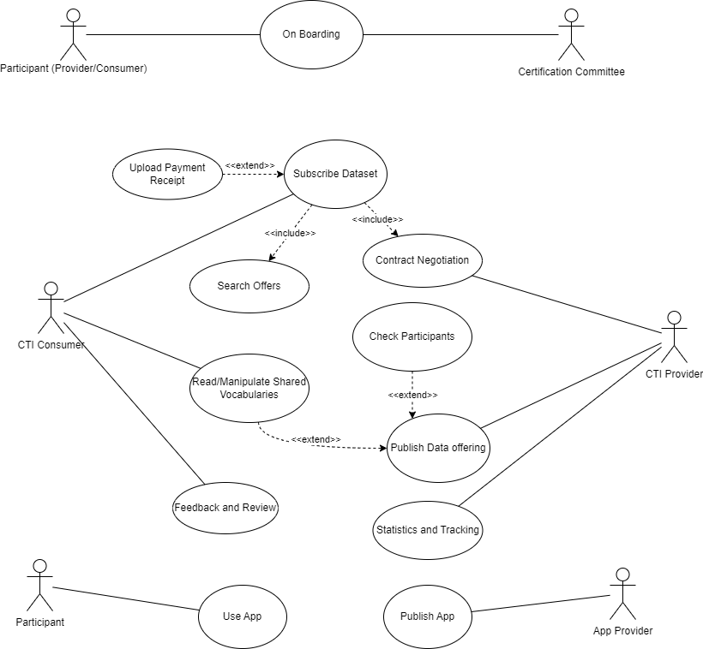
Use Case
A community of energy sector cyber security teams are sharing CTI (e.g. virus for SCADA, Mitigation Strategy)
One to One
Contract negotiation
Negotiation of Retention policy
Regulations
Share within EU (GDPR)
Automatic Sanitization
Limited Share (only IOCs) outside EU
Paid CTI (Marketplace)
Search offers
Bidirectional
Feedback on provider
Feedback on specific event (sighting)
Community CTI
Share within trusted group (NIS2)
Near-real time
Automatic integration to security systems
IDS / SIEM
Notes:
payment only after negotiation
Feedback and review
Change trust
Use in search offers
onion style requirements

Slide 74
Functional Requirements
Data Exchange
Feeds and events
Subscription and Publishing
Near real-time
Contract Negotiation, Search for offers
Co-annotations (Sightings)
Participant Management
Certification and Onboarding
Trust level and Reputation
Search for participants
Data Protection (and Security)
Usage Control
Based on location
Data Retention
Blacklisting
Confidentiality and Sanitization
Per field/data type
TLP / Blanking / Obfuscation / Anonymity (out of scope)
Compliance with regulations
Actionable and Interoperable
API for SIEM / IDS systems
Standard Machine-readable formats / Vocabularies
Trustable
Decentralized and Transparent
Incentive mechanism (Monetization)
payment receipt
Statistics and Tracking
Non-functional Requirements
Performance
Response time
Throughput
Security
Scalability
What happens on high user/load
Usability
Survey

Slide 75
Conceptual Approach
Identity Management
Automatic Sanitization
Usage policy enforcement
Feedback (reannotation, sighting, rating)
TBD (Broker?)
Reputation Management
TBD (Broker?)
Cataloguing
Cloud vs On-prem

Slide 76
Identity Provider
DAPS
Certificate Authority
IDS Connector
App
Sanitizer
Core
MYDATA
Notes:
Use your own diagram
Conceptual Approach
Higher level
Color code: new component
(Yellow) Changed:
(Green) New:

Slide 77
Evaluation
Validating functional requirements
Measuring non-functional requirements
Security Analysis
Comparative
MISP
Smart Grid w/o CTI sharing
Threat Modelling
Stride, Dread, QTMM, LINDDUN, PASTA
Discussion:
How could these results apply on different solutions?
Other limitations
Notes:
Community:
Social Network Analysis
Healthiness
Robustness
...

Slide 78
Timeline and Plan
Gantt Chart
Mini literature review
Requirement Analysis
Architecture Design
Setup General Data Space
User Management
Usage Control
Implement CTI Specific Requirements
Sanitization App
Real-time notification
API for IDS/SIEM systems
Reputation Management
Co-annotation
Evaluation
Validation
Performance
Security Analysis
Writing the thesis

Slide 79
Next Meeting
30 December

